Slide 1
CROWD MONITORING THROUGH DRONE IMAGE ANALYSIS
Submitted in the partial fulfillment for the award of the degree of
BACHELOR OF ENGINEERING
IN
Big Data and Analytics
Submitted by:
Siddharth Singh Bhadouria
20BCS3933
Under the Supervision of:
Mr. Mahadev Sir
Department of AIT-CSE
DISCOVER . LEARN . EMPOWER

Slide 2
Outline
Introduction to Project
Challenges
Advantages
Histogram of Oriented Gradients (HOG)
Results
Future Scope
Conclusions

Slide 3
Introduction to Project
Crowd monitoring plays a crucial role in various domains such as event management, public safety, and urban planning.
Drone image analysis offers a powerful solution for crowd monitoring, providing real-time data and wide coverage.
This presentation explores the utilization of drone image analysis techniques for effective crowd monitoring.

Slide 4
Challenges
Manual counting and surveillance methods are labor-intensive, time-consuming, and prone to errors.
Traditional techniques lack scalability and struggle to handle large crowds or crowded environments.
Limited field of view and fixed camera positions limit the effectiveness of existing monitoring systems.

Slide 5
Advantages
Drones offer dynamic aerial perspectives, capturing high-resolution images and videos from different angles.
Real-time monitoring capabilities enable immediate response to crowd dynamics and potential incidents.
Drones can cover large areas efficiently, providing a comprehensive view of crowd behavior.

Slide 6
Histogram Of Oriented Gradients (HOG)
The HOG algorithm is a popular technique for human detection in drone images.
HOG extracts local gradient orientation information to create a representation of human-like shapes.
By analyzing the distribution of gradients, HOG can robustly detect and localize humans in various poses and orientations.

Slide 7
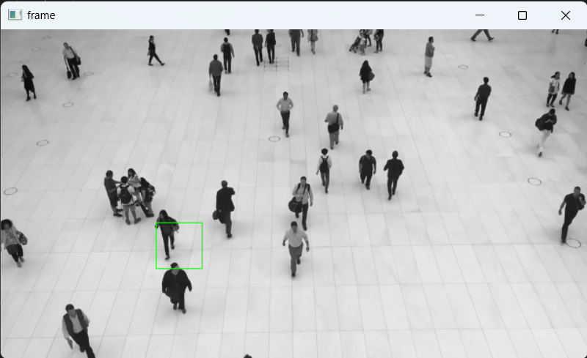
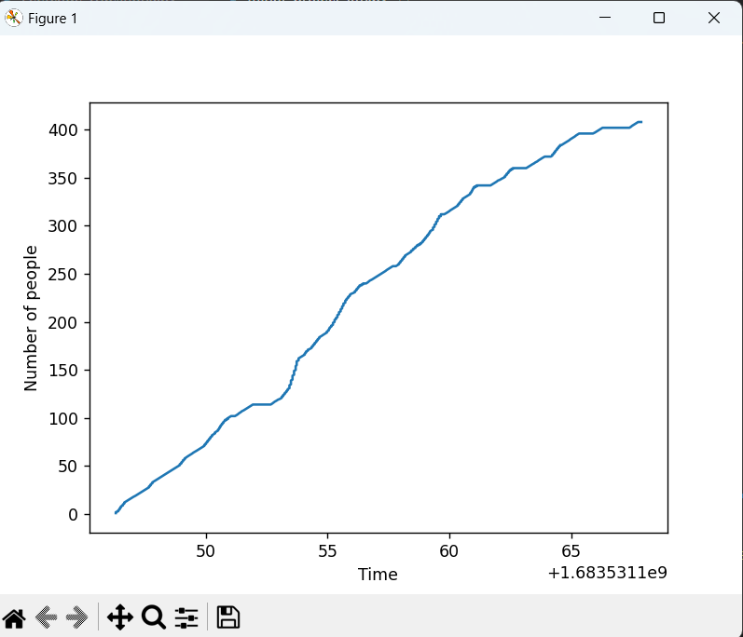
Results

Slide 8
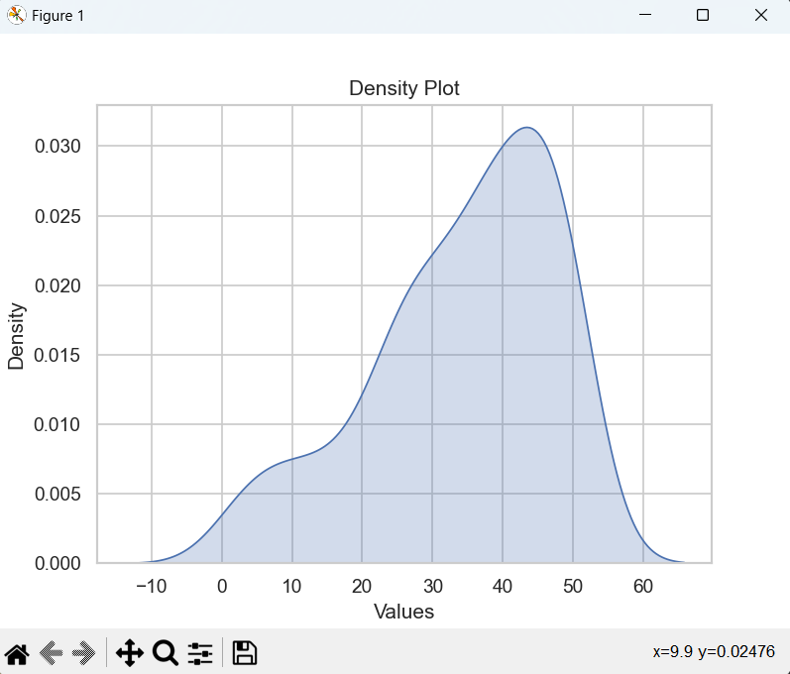


Slide 9
Future Scope
Advancements in drone technology for improved crowd monitoring
Higher-resolution cameras and sensors for enhanced image analysis
Integration of real-time video streaming for live monitoring
Use of autonomous drones for efficient data collection
Behavior analysis and anomaly detection to identify potential risks or unusual activities

Slide 10
Conclusion
Crowd monitoring through drone image analysis can be used for many purposes and can help in analyzing crowds and their patterns which can be profitable for companies and a saftey issue for government.
With the integration of many new technologies we can use drone image analysis for real time analysis and behaviour analysis.
It provides valuable insights for public safety, event management and urban planning.

